Slide 1
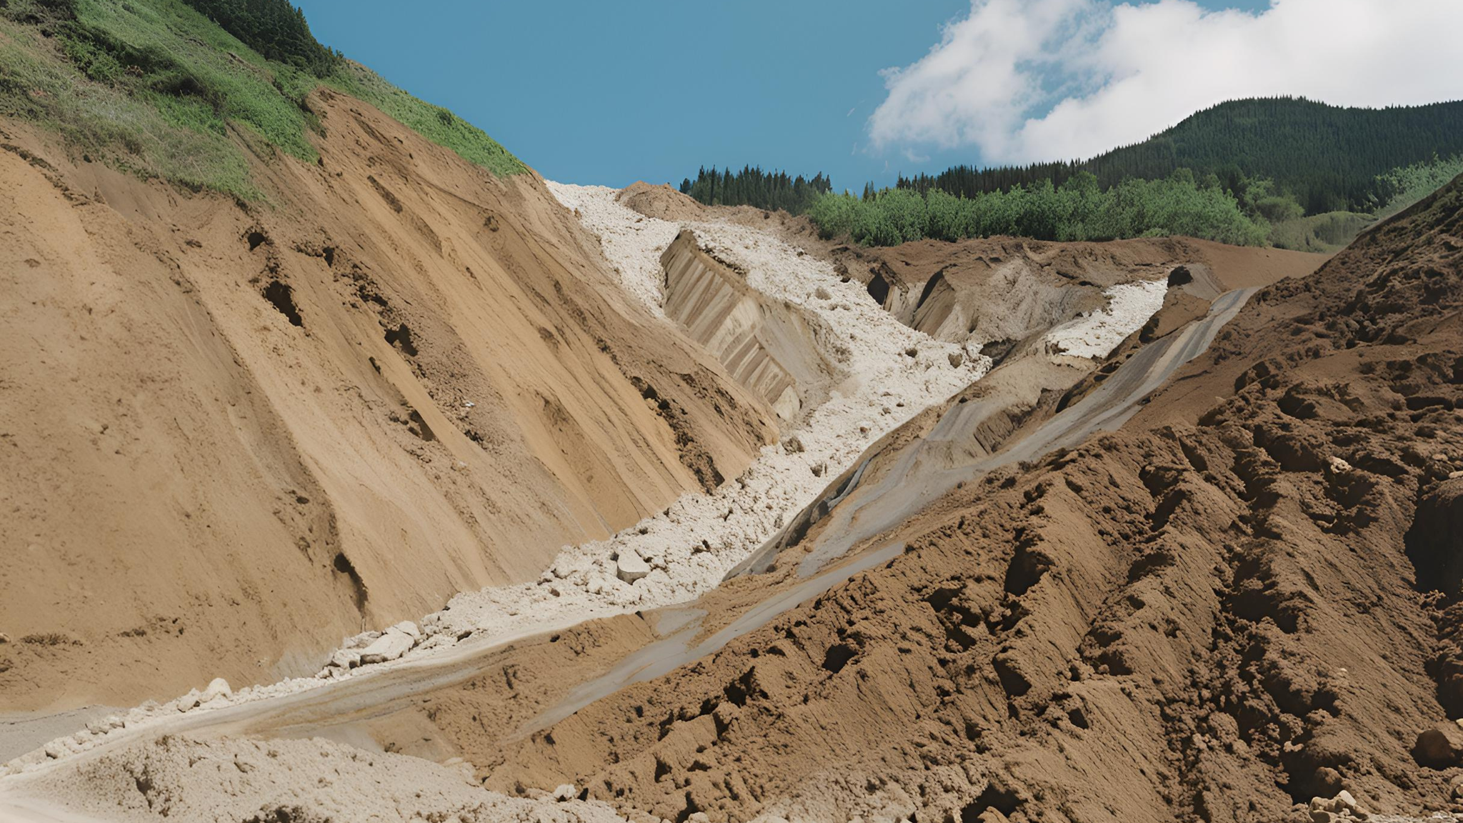
LANDSLIDE SUSCEPTIBLITY MAPPING WITh DEEP LEARNING
Project team:
Shivam Sharma (22BCS104)
Rizul Sharma (22BMA030)
Divesh Singh Chauhan (22BCS039)
Instructor: Dr. Kunjari Mog

Slide 2
OVERVIEW
ABOUT LANDSLIDES
STUDY AREA-HIMACHAL PRADESH
OBJECTIVE AND SIGNIFICANCE
DATA ACQUISITION
DATA PREPARATION OF MODEL
DEEP LEARNING MODEL DEVELOPMENT
RESULTS AND DISCUSSION
MITIGATION STRATEGIES
CONCLUSION
REFERENCES

Slide 3
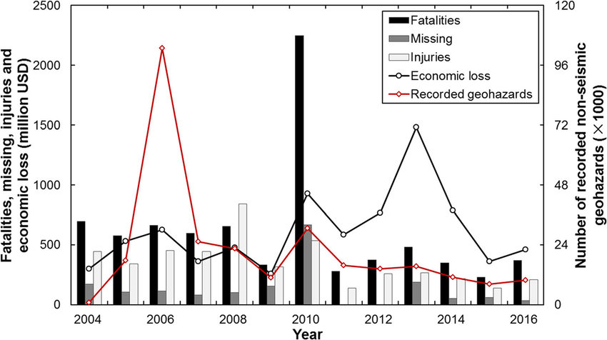
ABOUT LANDSLIDES
DEFINITION: Landslides are the downward movement of rock, soil, and debris along a slope, often triggered by gravity.
CAUSES: Intense rainfall, earthquakes, volcanic activity, deforestation, and human activities like construction.
IMPACT: Landslides cause tens of thousands of deaths and $20 billion in yearly economic losses globally estimated.

Slide 4
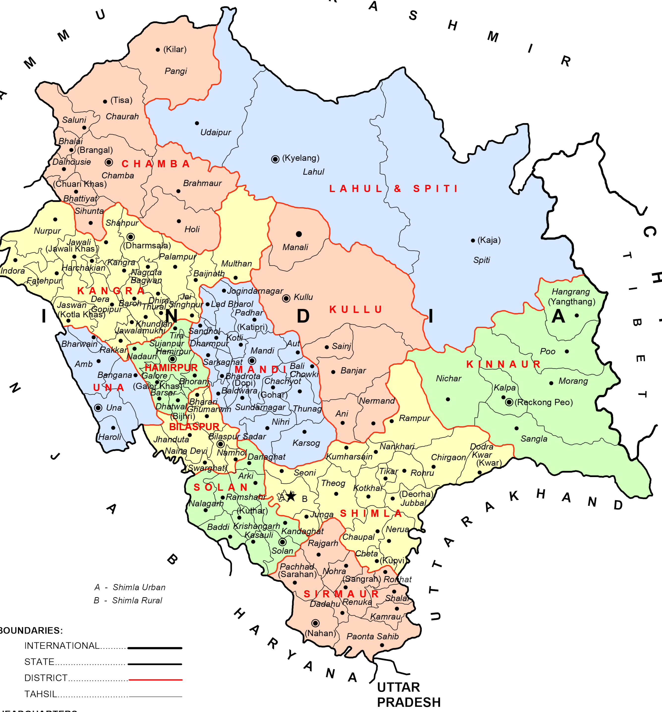
HIMACHAL PRADESH: Friend of landslides
Himachal Pradesh, in northern India, covers about 55,673 sq km within the western Himalayas.
6x increase in major landslides within two years, with 117 events in 2022 compared to 16 in 2020.
₹1,195 crore in losses, with extensive limiting access and heightening risks
Emphasizing the impact on us. REALLY US!

Slide 5
OBJECTIVE AND SIGNIFICANCE
OBJECTIVE: Develop a high-resolution landslide susceptibility map for Himachal Pradesh using DEEP LEARNING TECHNIQUES
SIGNIFICANCE:
(i) The resulting susceptibility map can be used for risk assessment,
infrastructure planning, community awareness and guiding mitigation strategies
(ii) This project underscores the transformative power of integrating machine learning
with geospatial data for managing natural hazards.

Slide 6
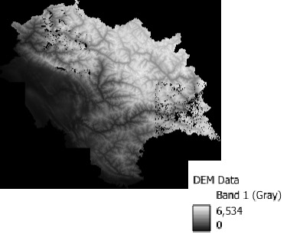
Methodology: data acquisition
Utilized remote sensing techniques to gather crucial information on various factors influencing landslide occurrence in Himachal Pradesh.
This included obtaining high resolution Digital Elevation Model (DEM) data to derive GEOMORPHOLOGICAL attributes such as altitude, slope, aspect, and ruggedness..

Slide 7
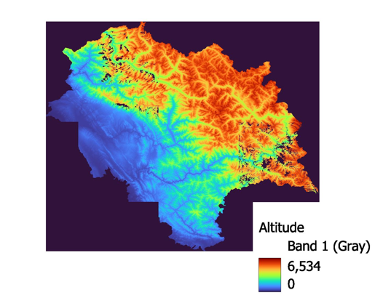
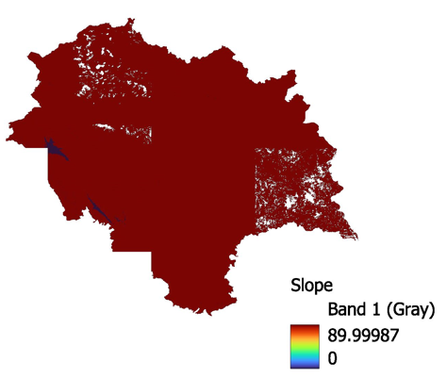
GEOMORPHOLOGICAL FACTORS
Landslide susceptibility mapping using analytical hierarchy process (AHP) and geographic information system (GIS): A study of the Garhwal Himalayas, India." This study indicates that areas at higher altitudes, where steep slopes are prevalent, are more susceptible to landslides due to natural terrain instability
ALTITUDE SLOPE

Slide 8
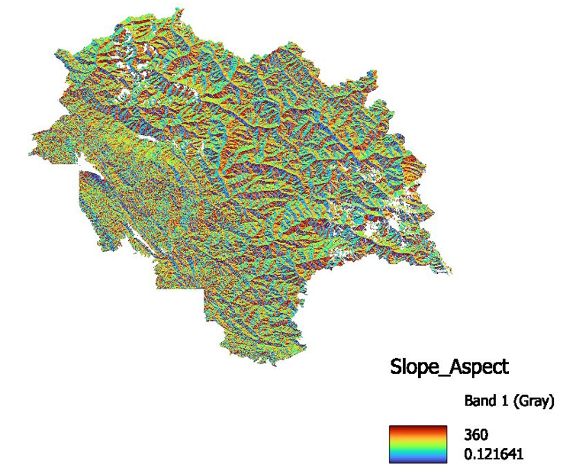
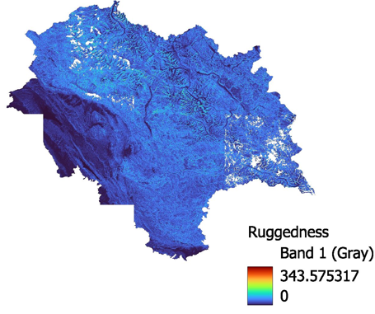
ASPECT RUGGEDNESS INDEX
Aspect is the orientation of slope, measured clockwise in degrees from 0 to 360, where 0 is north-facing, 90 is east-facing, 180 is south-facing, and 270 is west-facing.
TERRAIN RUGGEDNESS INDEX (TRI) highlights the amount of elevation difference between adjacent cells of a digital elevation model (DEM).

Slide 9
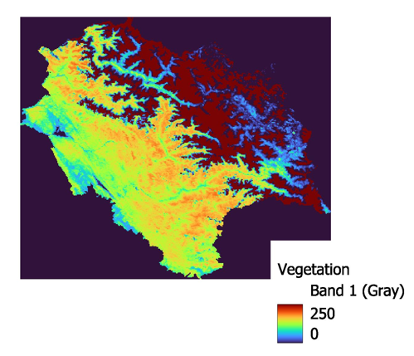
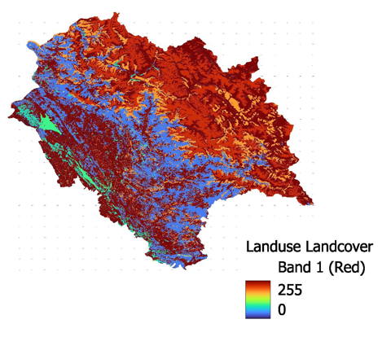
ENVIRONMENTAL FACTORS
The following studies motivated us to consider these factors a. Saha, S., & Sahu, M. (2018). "Role of vegetation in landslide susceptibility mapping: A case study in the western himalaya, india." Highlights how vegetation affects slope stability and the importance of including vegetation cover in landslide susceptibility mapping efforts.
VEGETATION LAND USE
LAND COVER

Slide 10
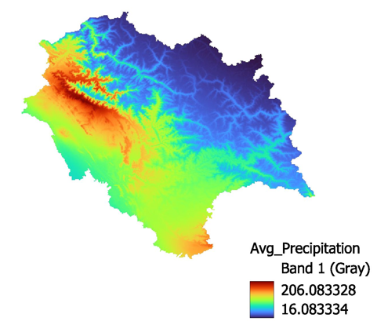
Cao, X., Chen, J., & Zhang, H. (2017). "Influence of precipitation on landslide susceptibility mapping in the Wenchuan earthquake area, China." Examines the relationship between precipitation patterns and landslide occurrences, emphasizing the importance of incorporating precipitation data in landslide susceptibility assessments.
AVERAGE PRECIPITATION

Slide 11
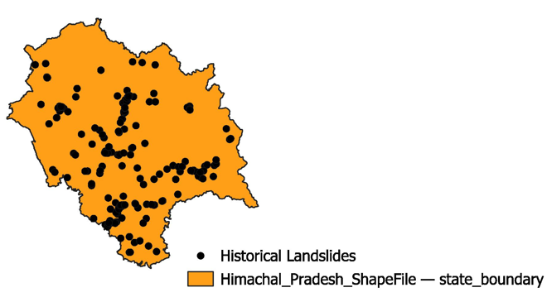
HISTORICAL LANDSLIDES DATA
Locations of past landslides were gathered to inform model training and validation.

Slide 12
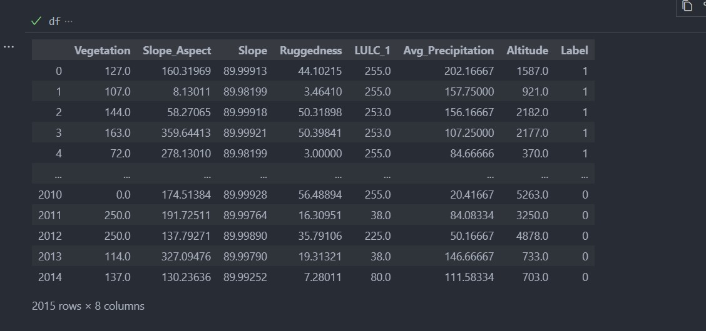
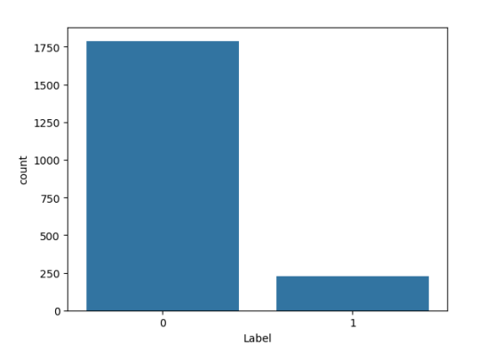
dAtA prepArAtIon For model
Point Sampling: We utilized QGIS’s point sampling tool to extract values from the factor maps at both historical landslide locations and an additional 2,000 random points.
Data Encoding: The extracted values were structured into a tabular format(.csv), with each row representing a point and columns corresponding to factor values, along with a binary label indicating landslide occurrence (1 for landslide, 0 for no landslide).
Train-Test Split: The dataset was divided into training (80%) and testing (20%) subsets to evaluate model performance.

Slide 13
METHODOLOGY: deep learning model development
We designed a Deep Neural Network (DNN) to analyze landslide susceptibility, using multiple hidden layers to capture complex spatial patterns:
Input layer : 7 neurons, each corresponding to a value of the particular feature
Hidden layers: 3 dense layers having 30,10 and 870 neurons respectively with ReL-U as activation function for each layer
Batch normalization: this layer was added to normalize the output of the previous layer, accelerating training and improving stability.
Dropout layer: a dropout rate of 0.5 was applied to reduce overfitting by randomly dropping half of the neurons during training.
Output layer: a single neuron with a sigmoid activation function was used to predict the probability of landslide occurrence (between 0 and 1).
Loss function: binary cross-entropy, suitable for binary classification.
Optimizer: adam optimizer, known for its efficiency and performance in training deep learning models.

Slide 14
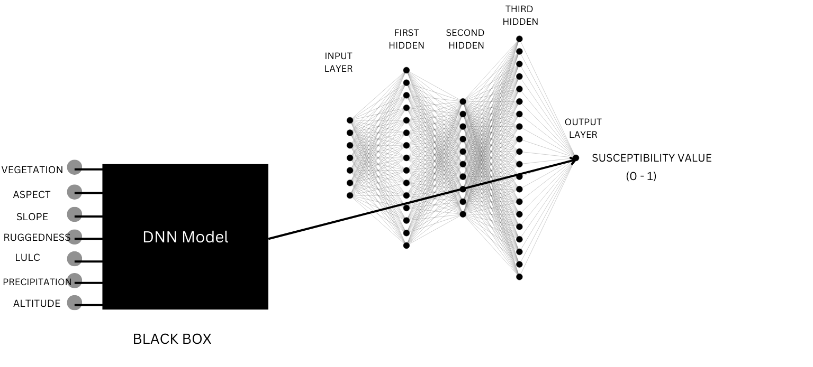
Accuracy: measured the percentage of correct predictions, giving a general indication of model performance. It was recorded as 87.84%.

Slide 15
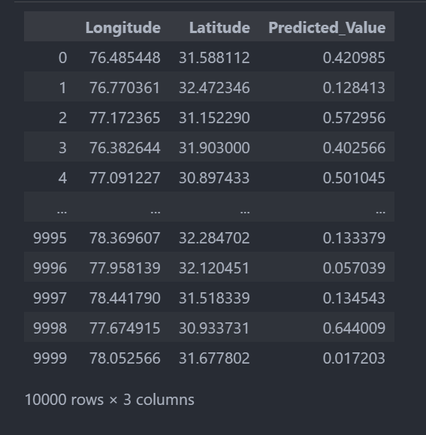
results
Using the trained deep neural network (DNN) model, we predicted the susceptibility values for each of the 10,000 coordinate points distributed across the region
The model, trained on historical landslide occurrences and various geomorphological and environmental factors, provides a continuous output representing the likelihood of landslide occurrence at each point.

Slide 16
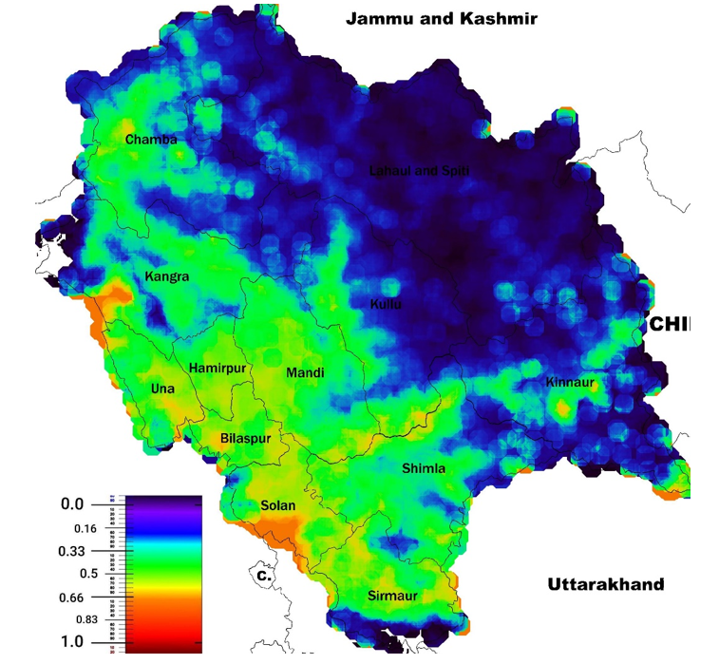
Landslide susceptibility map: Himachal Pradesh
PREDICTED VALUE | SUSCEPTIBILITY CLASS
(0 – 0.2) | VERY LOW SUSCEPTIBILITY
(0.2 – 0.4) | LOW SUSCEPTIBILITY
(0.4 – 0.6) | MODERATE SUSCEPTIBILITY
(0.6 – 0.8) | HIGH SUSCEPTIBILITY
(0.8 – 1) | VERY HIGH SUSCEPTIBILITY

Slide 17
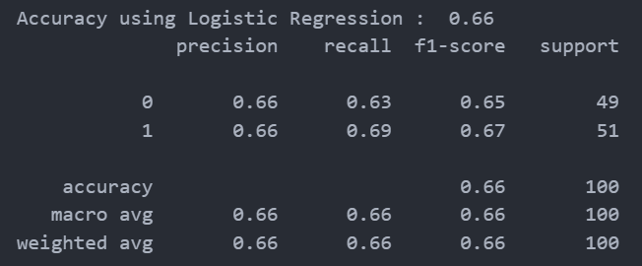
Comparison with other methods
Traditional methods
Traditional methods, like statistical models and heuristic approaches, often face limitations when handling high-dimensional datasets.
Our dnn model, by contrast, efficiently scales to handle extensive datasets from various sources, such as dem, vegetation, and precipitation.
2. Logistic regression model
Relies on a linear relationship between features and the outcome variable, which can be too simplistic for complex geospatial data.
While our DNN model utilises non linear activation
functions which make it better fit for capturing
complex interactions and nonlinear patterns
across factors.

Slide 18
Mitigation techniques
Susceptibility class | Region | Mitigation techniques | Strategies
Very High Susceptibility (0.8-1) | Chamba, parts of Kangra, Una, Solan (Orange to Red Zones) | -Deep Retaining Walls -Slope Stabilization through Rock Bolts | -Enforce Strict Zoning Regulations -Early Warning Systems: Install GPS-based
High Susceptibility (0.6-0.8) | Lower Kinnaur, South Shimla, Sirmaur, Solan (Yellow Zones) | -Medium Retaining Walls and Soil Nailing -Controlled Slope Regrading | -Land Use Planning -Regular Maintenance of Drainage Systems
Moderate Susceptibility (0.4-0.6) | Mandi, Bilaspur, Hamirpur (Green to Light Blue Zones) | -Small Retaining Walls and Geogrid Reinforcement | -Community Awareness Programs -Encourage Eco- Friendly Land Use
Low Susceptibility (0.2-0.4) | Kullu, Lahaul & Spiti, northern Chamba (Blue to Dark Blue Zones) | -Natural Vegetative Cover -Minimal Grading | -Periodic Monitoring -Soil Conservation Programs
Very Low Susceptibility (0-0.2) | Northern Lahaul & Spiti, Upper Kinnaur (Dark Blue Zones) | - Routine Maintenance | Basic Monitoring Sustainable Land Development

Slide 19
conclusion
This study has demonstrated the effectiveness of using deep learning techniques, specifically a dense neural network (DNN), for landslide susceptibility mapping in Himachal Pradesh.
The resulting susceptibility map and mitigation strategies not only highlight areas at high risk for landslides but also provides valuable insights for local authorities and planners in implementing effective disaster risk management strategies.
As the threat of landslides continues to pose significant risks to lives and infrastructure, this research highlights the necessity for proactive monitoring and risk mitigation strategies.
Overall, this work contributes to the growing body of knowledge on landslide susceptibility mapping and reinforces the importance of advanced methodologies in enhancing community resilience against natural hazards.

Slide 20
REFERENCES
U.S. Geological Survey. (n.d.). Earth Explorer. U.S. Department of the Interior. https://earthexplorer.usgs.gov/
National Remote Sensing Centre. (n.d.). Bhuvan: An Indian Geo-Platform. ISRO https://bhuvan.nrsc.gov.in/
QGIS Development Team. QGIS Geographic Information System. Open Source Geospatial Foundation Project
Fick, S. E., & Hijmans, R. J. (2017). WorldClim 2: New 1 km spatial resolution climate surfaces for global land areas. International Journal of Climatology, 37(12), 4302-4315.
Milevski, I. & Dragic´evic´, S. Landslides susceptibility zonation of the territory of north macedonia using analytical hierarchy process approach. Contrib. Sect. Nat. Math. Biotechn. Sci
Ayalew, L. & Yamagishi, H. The application of GIS based logistic regression for landslide susceptibility mapping in the KakudaYa hiko Mountains Central Japan. Geomorphology 65(1), 15–31 (2005).
Yao, X., Tham, L. & Dai, F. Landslide susceptibility mapping based on support vector machine: A case study on natural slopes of Hong Kong, China. Geomorphology 101, 572–582 (2008).
Lee, S., & Choi, J. (2004). Landslide susceptibility mapping using GIS and the weight-of- evidence model. International Journal of Geographical Information Science, 18(8), 789–814. https://doi.org/10.1080/13658810410001702003
Stanley, T. A., D. B. Kirschbaum, G. Benz, et al. 2021. "Data-Driven Landslide Nowcasting at the Global Scale." Frontiers in Earth Science, 9: 3389/feart.2021.640043
Stanley, T., and D. B. Kirschbaum. 2017. "A heuristic approach to global landslide susceptibility mapping." Natural Hazards, 1-20 1007/s11069-017-2757-y
Zhang, Fanyu & Huang, Xiaowei. (2018). Trend and spatiotemporal distribution of fatal landslides triggered by non-seismic effects in China. Landslides. 15. 10.1007/s10346-018-1007-z.

